Slide 1
Docker Orchestration:
Step-by-step
@mrmrcoleman
implicit-explicit.com
container-solutions.com

Slide 2
Are we nearly there yet?
Introductory stuff (small)
Orchestration (big)
Service Discovery (medium)
Future stuff and questions (up to you…)

Slide 3
Who am I?
Co-founder Docker Amsterdam
Co-founder DockerCon Europe
Associate at Container Solutions
@mrmrcoleman

Slide 4
About container solutions
Started in Amsterdam in 2014
Now also in London
Coming soon to Denmark
Hiring…
Programmable infrastructure
Docker
Mesos
20% time to work on fun things

Slide 5
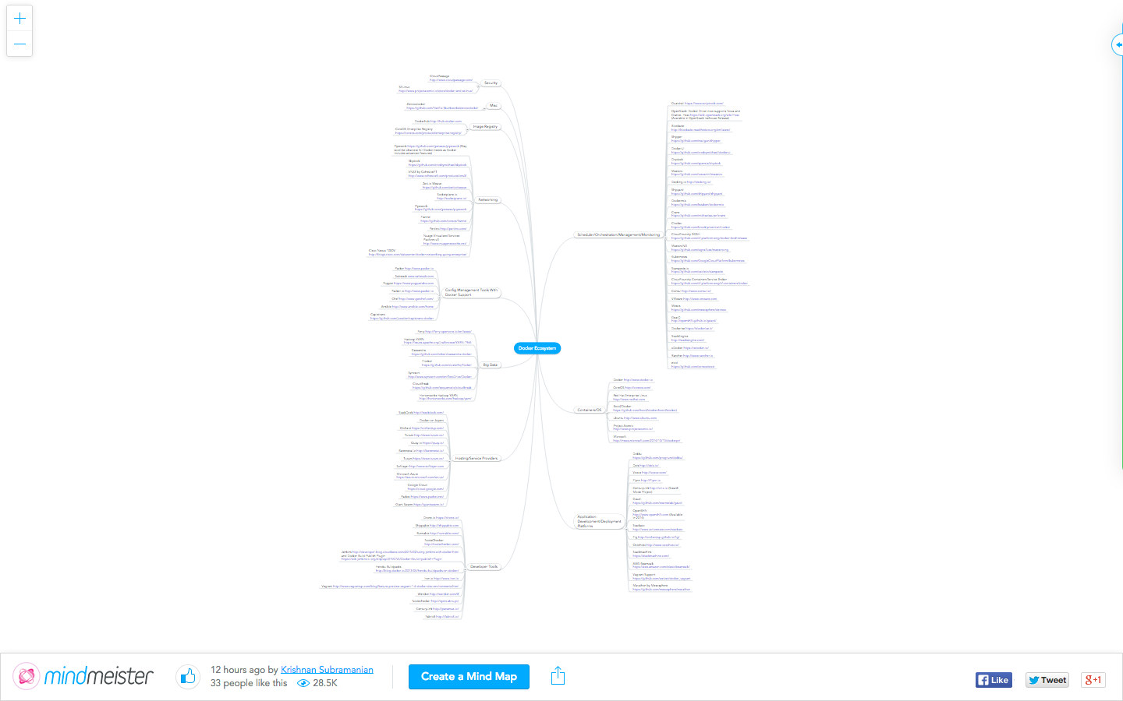
About this talk
Notes:
What are the ability levels?
There’s too much to cover properly
Cover some orchestration, and some service discovery. If you understand what those terms mean by the time you leave, I’ll be happy
1st public outing so feel free to interupt me to clarify things

Slide 6
Are we nearly there yet?
Introductory stuff (small)
Orchestration (big)
Service Discovery (medium)
Future stuff and questions (up to you…)

Slide 7
Orchestration - What is it?
Right side of ‘the wall’
“Stuff needs to happen in the right order”
Intertwined with service discovery
DAGs
Notes:
Software delivered as loads of little bits. Normally these bits have dependencies. This creates DAGs. Something needs to manage these DAGs.
“deploy_myself.sh” is an anti-pattern

Slide 8
Example 1 - 1 DockerHost
Docker Compose, formerly known as Fig
fig.yml describes desired state
‘docker up’
https://github.com/docker/fig
Notes:
Introduce what a DockerHost is

Slide 9
fig.yml
containers: web: image: mydockerrepo/mywebapp:latest command: python app.py ports: - "5000:5000" volumes: - .:/code links: - redis environment: - PYTHONUNBUFFERED=1 redis: image: redis:latest command: redis-server --appendonly yes

Slide 10
Example 2 - 2 DockerHosts
Flocker from ClusterHQ built on top of Fig
application.yml same as fig.yaml
deployment.yml describes where the containers should run
Deals with migrations
Moves persistent volumes
Re-routes network traffic

Slide 11
deployment.yml
"version": 1
"nodes":
"172.16.255.250": ["logstash", "kibana"]
"172.16.255.251": ["elasticsearch"]
flocker-deploy deployment.yml application.yml

Slide 12
Example 3 - Loads of DockerHosts
“Cluster Management” makes your cluster of servers looks like one machine
Mesos + Marathon
Schedule Docker containers
Separation of Concerns
Used at Twitter
Competitors: CoreOS, Kubernetes, Docker Swarm, etc

Slide 13
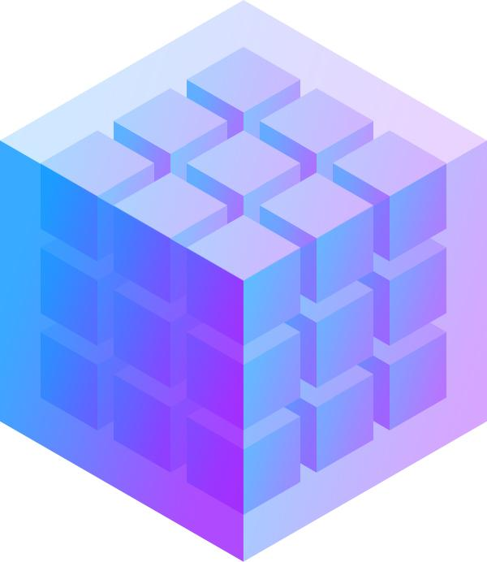
Example 3 - Loads of DockerHosts
CLI or JSON/REST API
Marathon
Mesos
Notes:
Automatically figures out where to run your container based on several constraints
Affinity/Anti-Affinity settings
Container hardware requirements cores, memory etc)
When we get to this scale we tend to stop orchestrating everything from ‘outside’ and make the containers a bit smarter
We’ll come back to this in the service discovery part

Slide 14
Are we nearly there yet?
Introductory stuff (small)
Orchestration (big)
Service Discovery (medium)
Future stuff and questions (up to you…)

Slide 15
Service Discovery - What is it?
Agility vs Resilience
Agility requires that applications be split
Resilience requires that application components “work anywhere”
The container sandwich
DNS not going to cut it anymore...
etcd, skydock, zookeeper, doozerd, Consul
Notes:
The basic idea is that our containers need to wake up somewhere and say “Hello World… tell me who I should talk to to get my job done..!”

Slide 16
Consul
Uses RAFT gossip protocol to keep everything in sync
Highly scalable
REST or DNS
I’ve used it, and it seems to “just work”

Slide 17
Consul
DH + Consul
DH + Consul
DH + Consul
DH + Consul
Notes:
We can use watches and handlers to orchestrate on the fly
Load balancer running on node 1
Bunch of webapps spread across the other nodes
We need to scale up, so we push a new webapp to one of the nodes

Slide 18
Are we nearly there yet?
Introductory stuff (small)
Orchestration (big)
Service Discovery (medium)
Future stuff and questions (up to you…)

Slide 19
Open docker questions and
future stuff
Inter-dockerhost networking
Storage
VulcanD <- programmatic load balancer
Decentralised Orchestration?
Docker-based PAAS offerings

Slide 20
Thank you
@mrmrcoleman
www.implicit-explicit.com

